Slide 1

Using Google Cloud Messaging Service in Android
Zoran Kos*, Zlatko Stapić
 | University of Zagreb Faculty of Organization and Informatics Pavlinska 2, 42000 Varaždin, Croatia http://www.foi.unizg.hr/
* Student at University of Zagreb, FOI Varazdin
CASE26 – Developers conference - 03.06.2014. – Zagreb, Croatia

Slide 2
Agenda
Introduction
How to implement GCM Client
Conclusion
How to implement GCM Server
The main GCM characteristics
User notification
Vulnerabilities and threads

Slide 3
Introduction 1/2
Google cloud messaging (GCM) for the Android platform is a service that provides applications’ programmers and developers to communicate with applications installed on smart phones, tablets, Chrome apps and extensions, from servers.
GCM is a service that allows you to send data from your server to your users' Android-powered device, and also to receive messages from devices on the same connection.

Slide 4
Introduction 2/2
GCM was officially presented in 2012. at Google I/O conference in San Francisco, California.
Google uses GCM for the processing and sending instant notifications for many popular applications including Twitter, Facebook and Gmail.
Google play services SDK and GoogleCloudMessaging methods.
Before using GCM ther was the Android Cloud to Device Messaging service (C2DM).
It takes 4.7 ms to deliver the messages.

Slide 5
The main GCM characteristics 1/4
The GCM architecture contains the three following main components:
Client Application – receives the message from GCM connection server initially sent by the application server and sends the new message to the same server.
3^{rd-}party Application server – receives the client app registration ID; based on the registration ID records in the database sends the message to the GCM connection server.
GCM connection server – receives the messages from the application server and sends these messages to the GCM enabled android devices.

Slide 6
The main GCM characteristics 2/4
Credentials can ensure that all components have been properly authenticated so that data transfer and messaging is going to the correct place and without delay.
Sender ID – a project number given from API console;
Application ID – located in Android manifest and identified by the package name;
Registration ID – tied to a particular app running on a particular device;
Google User Account – used only if user’s Android version is lower than 4.0.4.;
Sender Auth token – saved on the 3rd-pary app server; it gives app server authorized acces to Google services.

Slide 7
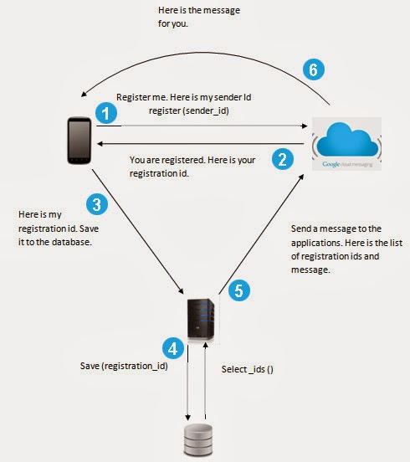
The main GCM characteristics 3/4
GCM Life cycle flow
Enable GCM
Send a message
Receive a message

Slide 8
The main GCM characteristics 4/4
Messages with payload
Send-to-Sync messages
Multicast messages
Multiple senders
Time-to-live messages
Two main GCM connection server types
GCM HTTP Connection server
GCM Cloud Connection server
Upstream messaging – device-to-cloud feature of Cloud connection server (CCS)
Seamless multi-device messaging
JSON format
Messages sent as HTTP POST
Encapsulated in XMPP messages

Slide 9
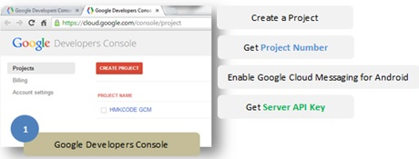
How to implement GCM Client 1/4
GCM can be used in java project, some steps should be taken:
Installation of Google Play services SDK – provides the GCM methods; it can be used with Eclipse ADT environment.
Creating a Google API project inside the Google Developers Console – it creates project ID and project number.
Enabling the GCM service API inside created project in API console.
Creating a Server API key – with option to whitelist specific IP addresses. This key is used by developer’s server app as a password when connecting to Google’s Command and Control server (CCS).

Slide 10
How to implement GCM Client 2/4
Permissions in the Android application manifest:
com.google.android.c2dm.permission.RECEIVE – app can register and receive messages.
com.google.android.c2dm.intent.RECEIVE – if set, only the GCM Framework can send a message to it;
WakefulBroadcastReceiver passes off the work of handling the GCM message
android.permission.INTERNET – for sending registration ID to the 3rd party server.
android.permission.GET_ACCOUNTS – if mobile device is running on lower API then Android 4.0.4, GCM must require a Google account.
android.permission.WAKE_LOCK – client app can keep the processor from sleeping when a message is received.
applicationPackage.permission.C2D_MESSAGE – prevents other apps from registering and receiving the GCM message.

Slide 11
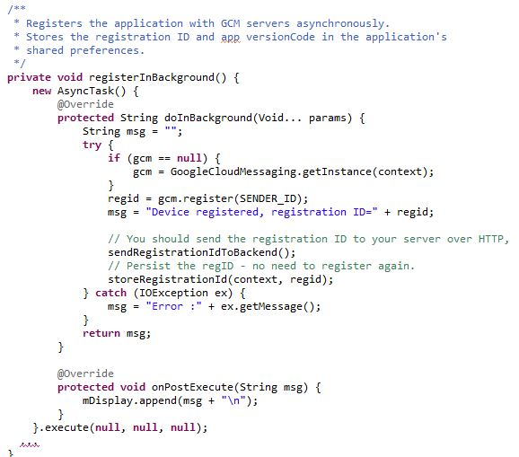
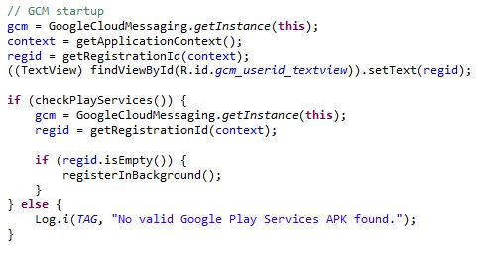
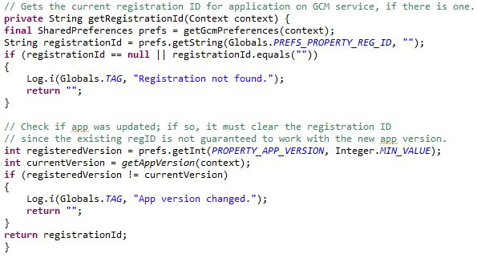
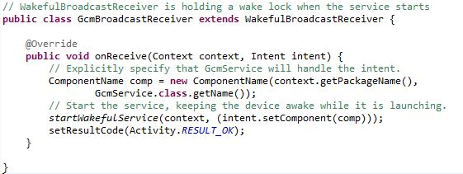
How to implement GCM Client 3/4
Writing an Android application
Main activity;
WakefulBroadcastReceiver;
IntentService – asynchronous requests on demand

Slide 12
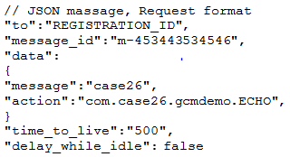
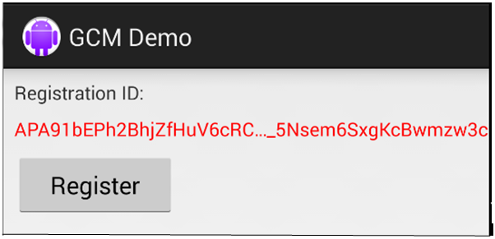
How to implement GCM Client 4/4
The GCM message is a JSON object containing some required and optional fields. There are several different formats depending on the direction in which communication goes:
Request format - from a 3rd-party app server or client app to CCS.
Response format – from CCS to 3rd-party app server (including ACK and NACK message formats).

Slide 13
How to implement GCM Server 1/2
3rd-party server must be able to communicate with client and GCM Connection Servers with properly formatted requests and be able to respond incoming requests to it.
Sending Messages
The application server sends a message to GCM servers.
Google enqueues and stores the message in case the device is offline.
When the device is online, Google sends the message to the device.
On the device, the system broadcasts the message to the specified Android application via Intent broadcast with proper permissions
The Android application processes the message.

Slide 14
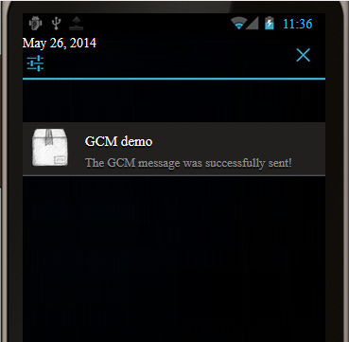
How to implement GCM Server 2/2
“Push Bot” services API
Push Bot can push notifications via XMPP to feeds that support server-to-server PuBSUBHubbub protocol.

Slide 15
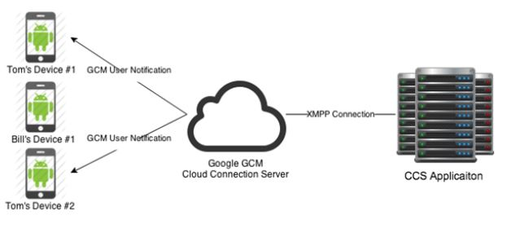
User notification
User notification is feature that enables 3rd-pary app server to send a single or multiple messages to client apps and app instance that a user owns to reflect the latest messaging state.
To create a user notification key, a JSON request must be sent to GCM Notification endpoint;

Slide 16
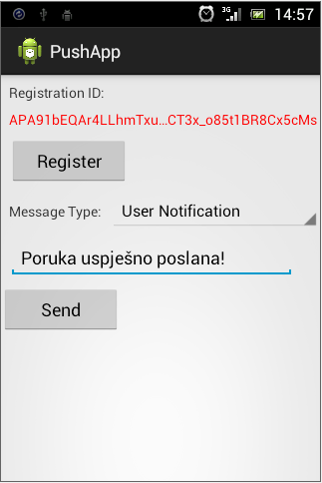
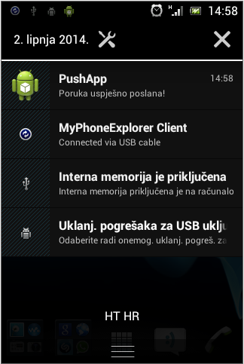
Example on smartphone

Slide 17
Vulnerabilities and threads 1/2
In sommer of 2013. Kaspersky Lab, computer Security Company, has announced that they have found a backdoor in GCM service.
Messages are sent in JSON format what enables hackers to take advantage for malicious purposes.
The top three most Android Trojans that used JSON format are:
SMS.AndroidOS.OpFake.bo
SMS.AndroidOS.FakeInst.a
SMS.AndroidOS.OpFake.a

Slide 18
Vulnerabilities and threads 2/2
Once gained a GCM ID, malware updates are distributed exploiting directly the GCM services.
“Trojan-SMS.AndroidOS.OfFake.bo is one of the most sophisticated SMS Trojans. Its distinguishing features are a well-designed interface and the greed of its developers. When launched, it steals money from the mobile device’s owner – from $9 to the entire amount in the user’s account. There is also the risk of the user’s telephone number being discredited, since the Trojan can collect numbers from the contact list and send SMS messages to all of those numbers. The malware targets primarily Russian-speakers and users in CIS countries.” (Chebyshev and Unuchek, 2013)

Slide 19
Conclusion
GCM provides programmers and developers the possibility to send notifications and data to smart phones’ or tablet’s installed applications, by means of using the Web services.
Key concepts of GCM are the components which make the architecture of GCM and the credentials used for access authentication in different stages of GCM.
Components include client app that runs on Android device, 3rd-party app server and GCM connection server.
Credentials are the IDs and tokens used in different stages of GCM (Sender ID, application ID, registration ID, google user account and sender auth token).

Slide 20

Looking forward to your questions ☺

Slide 21
References
[1] Android Developers, 2014a. GCM Overview [WWW Document]. Google Cloud Messaging - Overview. URL http://developer.android.com/google/gcm/gcm.html (accessed 5.9.14).
[2] Android Developers, 2014b. Implementing GCM Client [WWW Document]. Implementing GCM Client. URL http://developer.android.com/google/gcm/client.html (accessed 5.9.14).
[3] Android Developers, 2014c. Implementing GCM Server [WWW Document]. Implementing GCM Server. URL http://developer.android.com/google/gcm/server.html#choose (accessed 5.12.14).
[4 Cambell, A., 2013. Google Cloud Messaging: Cloud Connection Server Tutorial [WWW Document]. CapTech consulting. URL http://captechconsulting.com/blog/antoine-campbell/google-cloud-messaging-cloud-connection-server-tutorial (accessed 5.9.14).
[5] Chebyshev, V., Unuchek, R., 2013. Mobile Malware Evolution: 2013 - Securelist [WWW Document]. URL http://www.securelist.com/en/analysis/204792326/Mobile_Malware_Evolution_2013?print_mode=1 (accessed 5.19.14).

Slide 22
References
[6] freelancersnepal, 2014. Google Cloud Messaging (GCM) in Android using PHP Server [WWW Document]. URL: http://freelancersnepal.wordpress.com/2014/01/29/google-cloud-messaging-gcm-in-android-using-php-server/ (accessed 5.20.14).
[7] Google Developers, 2013. Google I/O 2013 [WWW Document]. Google I/O 2013. URL https://developers.google.com/events/io/ (accessed 5.26.14).
[8] PushBots, 2012. PushBots: communicate with your mobile app users in minutes [WWW Document]. PushBots. URL https://pushbots.com (accessed 5.26.14).
[9] HMKCode, 2014. Android Google Cloud Messaging Tutorial [WWW Document]. Android Google Cloud Messaging Tutorial, URL: http://hmkcode.com/android-google-cloud-messaging-tutorial/ (accessed 5.20.14).

Slide 23
Information on authors
Zoran Kos B.Sc
zoran.kos@foi.hr
Zoran Kos is 2nd year student of Information and Programming engineering of Faculty
of Organization and Informatics in Varaždin. Main interests are programming web,
desktop and mobile application, new IT trends like cloud computing and mobility,
making and presenting business models for startup projects. While developing new
apps he focused on front-end development. He already has few smaller but successful
projects behind him.

Slide 24
Information on authors
Zlatko Stapić, PhD.
zlatko.stapic@foi.hr
Faculty of Organization and Informatics
Pavlinska 2, 42000 Varaždin, Tel: +385 42 390 820, Fax: +385 42 213 413
Zlatko Stapić, PhD., works at the Information Systems Development Department at
Faculty of Organization and Informatics in Varaždin. He obtained his PhD in computer
sciences from University of Alcalá (Spain) and in information sciences from University of
Zagreb (Croatia) in cotutelled doctorate program. His scientific and research interests
include software- and mobile applications development methodologies. He participated
in more than 15 scientific and professional projects and published more than 30
scientific and professional papers. Currently he leads the Laboratory for Development
and Transfer of Mobile Technologies (FOI MT-Lab). Zlatko is putting a special focus in
inclusion of students in his scientific and professional activities. The published papers,
projects, awards and other relevant information can be found on his personal website:
http://www.foi.unizg.hr/djelatnici/zlatko.stapic.

